Slide 1
Insert Presentation Title Here Insert Presentation Title Here Insert Presentation Title Here Insert Presentation Title Here
Insert Presentation Subtitle Here Insert Presentation Subtitle Here Insert Presentation Subtitle Here Insert Presentation Subtitle Here
PRESENTED BY
Presenter Name(s)

Slide 2
Disclosures
[Speaker 1 Name], faculty for this event, has no relevant financial relationship(s) with ineligible companies to disclose.
[Speaker 2 Name, if applicable], faculty for this event, has no relevant financial relationship(s) with ineligible companies to disclose.
None of the planners for this educational activity have relevant financial relationship(s) with ineligible companies to disclose.
An “ineligible company” includes any entity whose primary business is producing, marketing, selling, re-selling, or distributing healthcare products use by or on patients.
All content contained in this presentation represents the opinions of the presenter(s), not those of Today’s Dietitian (“TD”) or any organization with which the presenter(s) may be affiliated. TD, its publisher, owner, employees, affiliates and agents do not assume responsibility for the opinions expressed by the presenter(s) or individuals quoted in this session.
All content contained in the presentation is created for informational purposes only and shall not be construed to diagnose, cure, or treat any medical, health, or other condition. Moreover, the content in the presentation is no substitute for individual patient/client assessment based upon the professional’s examination of each patient/client and consideration of laboratory data and other factors unique to the patient/client.
Content contained in this session shall not be construed to constitute professional medical, health, legal, tax or financial advice.

Slide 3


Accreditation Statement
In support of improving patient care, Great Valley Publishing Company is jointly accredited by the Accreditation Council for Continuing Medical Education (ACCME), the Accreditation Council for Pharmacy Education (ACPE), and the American Nurses Credentialing Center (ANCC), to provide continuing education for the healthcare team.
This activity will also award credit for dietetics (CDR CPEU).
Dietitians:
This activity will also award 1.0 CDR CPEU credit for dietetics. Completion of this RD/DTR profession specific or IPCE activity awards CPEUs (1 IPCE credit = 1 CPEU). If the activity is dietetics-related but not targeted to RDs or DTRs, CPEUs may be claimed which are commensurate with participation in contact hours (1 hour/60 minutes = 1 CPEU). RDs and DTRs are to select activity type 102 in their Activity Log. Sphere and Competency selection is at the learner's discretion.
Physicians:
Great Valley Publishing designates this live material for a maximum of 1.0 AMA PRA Category 1 Credit (s)™. Physicians should claim only the credit commensurate with the extent of their participation in the activity.
Interprofessional:
This activity was planned by and for the healthcare team, and learners will receive 1.0 IPCE credit for learning and change.
Social Workers:
As a Jointly Accredited Organization, Great Valley Publishing Company is approved to offer social work continuing education by the Association of Social Work Boards (ASWB) Approved Continuing Education (ACE) program. Organizations, not individual courses, are approved under this program. Regulatory boards are the final authority on courses accepted for continuing education credit. Social workers completing this course will receive 1.5 general types of continuing education credits.

Slide 4
Learning Objectives
Sandite nobit aut ut qui rest rero Ipis ut quibus, ut at quaspic te
Sandite nobit aut ut qui rest rero Ipis ut quibus, ut at quaspic te
Sandite nobit aut ut qui rest rero Ipis ut quibus, ut at quaspic te
Sandite nobit aut ut qui rest rero Ipis ut quibus, ut at quaspic te
Sandite nobit aut ut qui rest rero Ipis ut quibus, ut at quaspic te

Slide 5
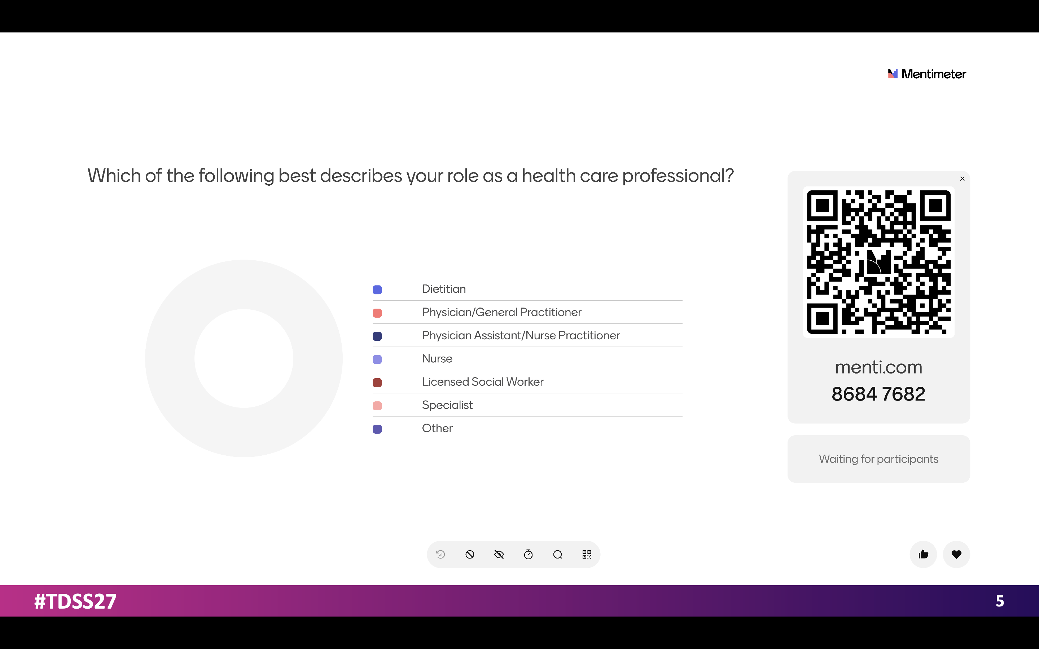

Slide 6
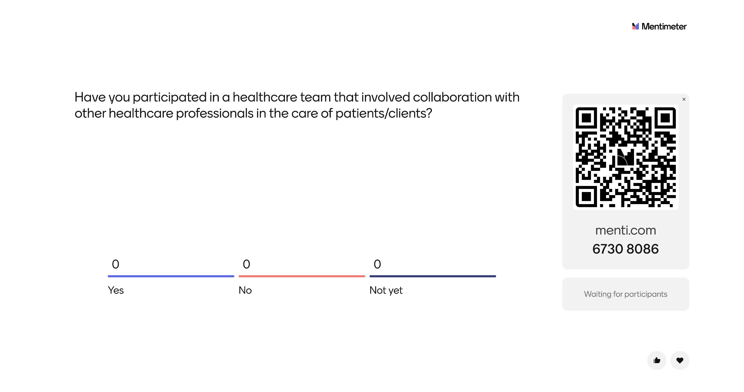

Slide 7
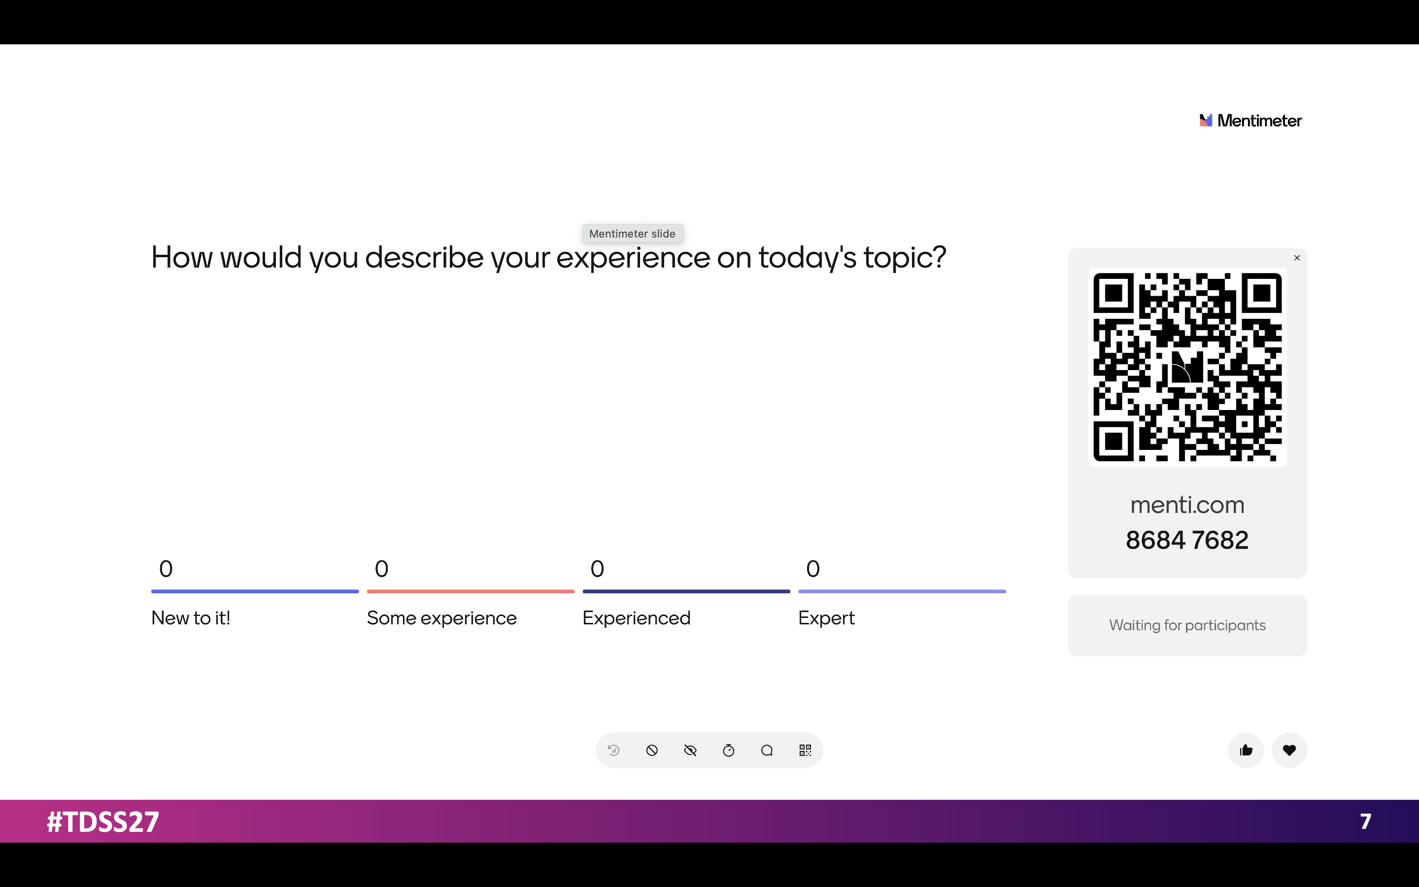

Slide 8
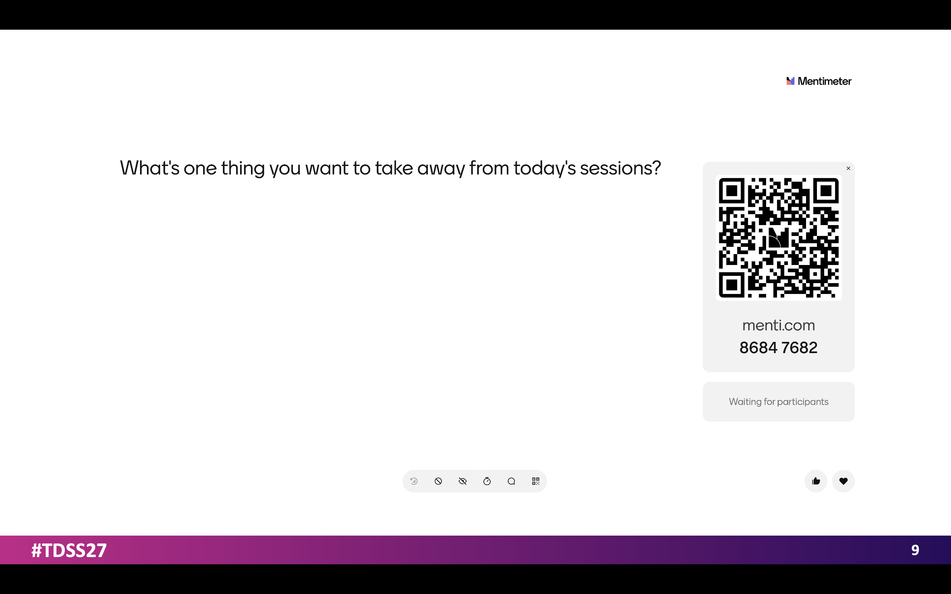
8

Slide 9
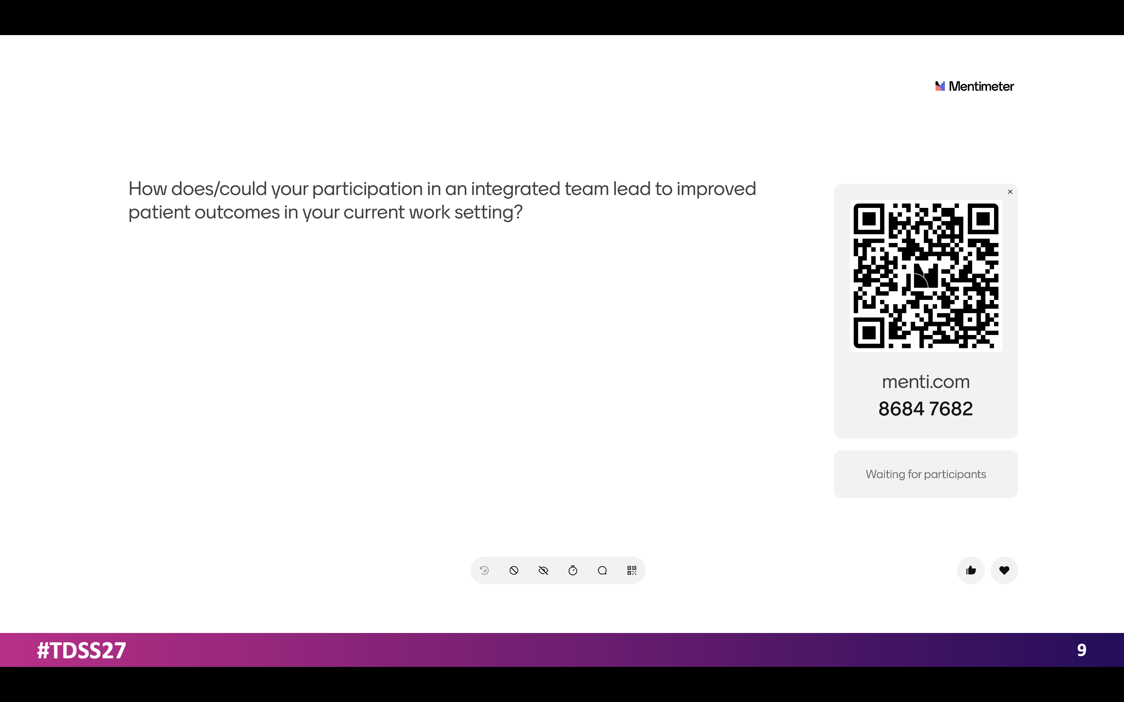

Slide 10
The Interprofessional Team
Who are the members and what are their roles

Slide 11
Interprofessional Team: Who is Involved?
SPECIALIST
DIETITIAN
PA/NP
PHYSICIAN
PATIENT
NURSE
SOCIAL WORKER

Slide 12
Interprofessional Team: Who Does What?
REGISTERED DIETITIANS
PHYSICIAN
SOCIAL WORKERS
Insert roles here
Insert roles here
Insert roles here
Insert roles here
Insert roles here
Insert roles here
NURSE
NP/PA
SPECIALISTS
Insert roles here
Insert roles here
Insert roles here
Insert roles here
Insert roles here
Insert roles here
Notes:
Determined largely by the treatment plan, which is why ongoing interpersonal communication is crucial
So much overlap when considering energy levels. Both disciplines are monitoring and encouraging compliance with treatment recommendations

Slide 13
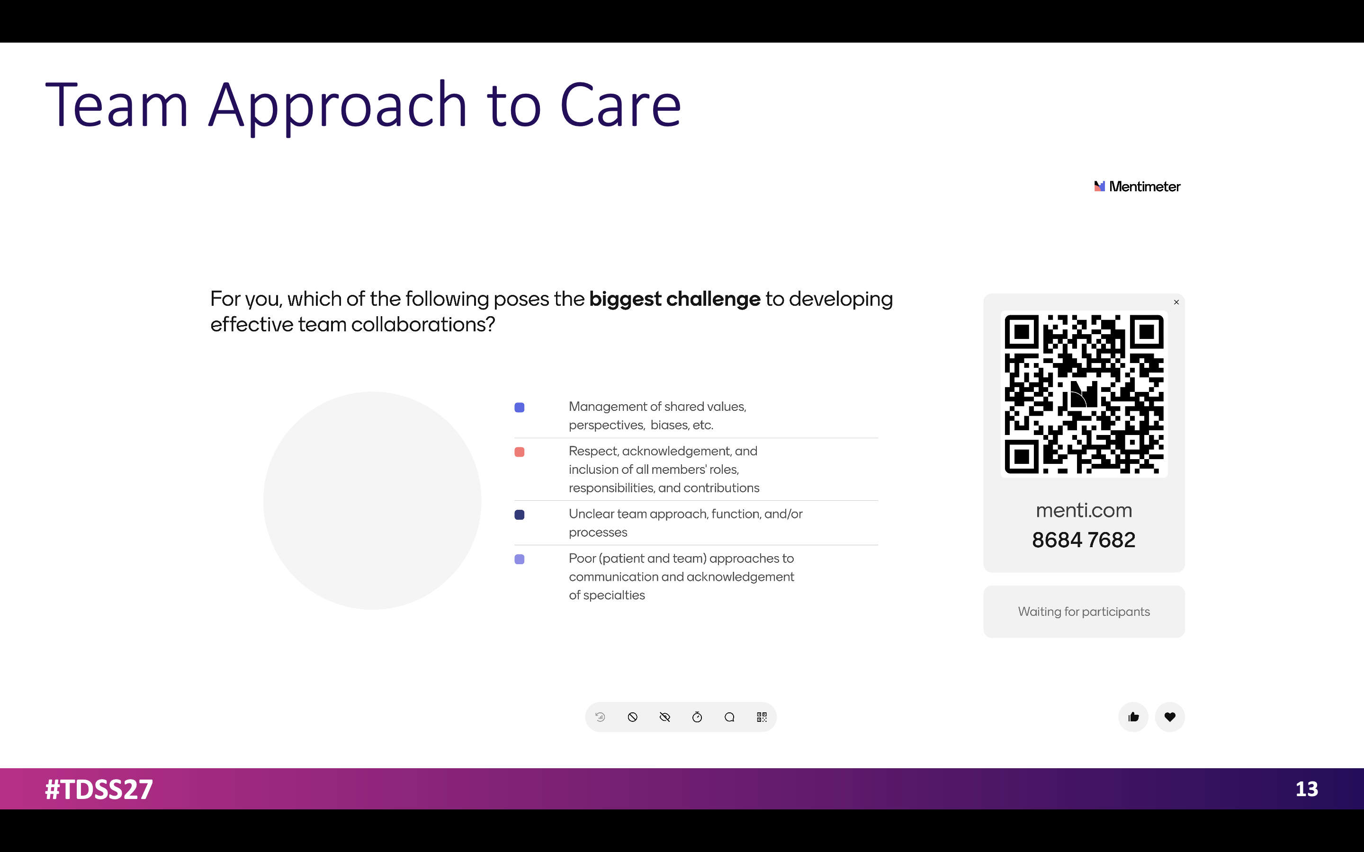
13

Slide 14

14

Slide 15
Barriers + Solutions to Challenges
BARRIERS
SOLUTIONS
Barrier 1
Barrier 2
Barrier 3
Solution 1
Solution 2
Solution 3

Slide 16

Case Study

Slide 17
Putting It In Practice Slide(s) Goes Here
Text will go here
Text will go here
Text will go here
Text will go here
Text will go here
Text will go here

Slide 18
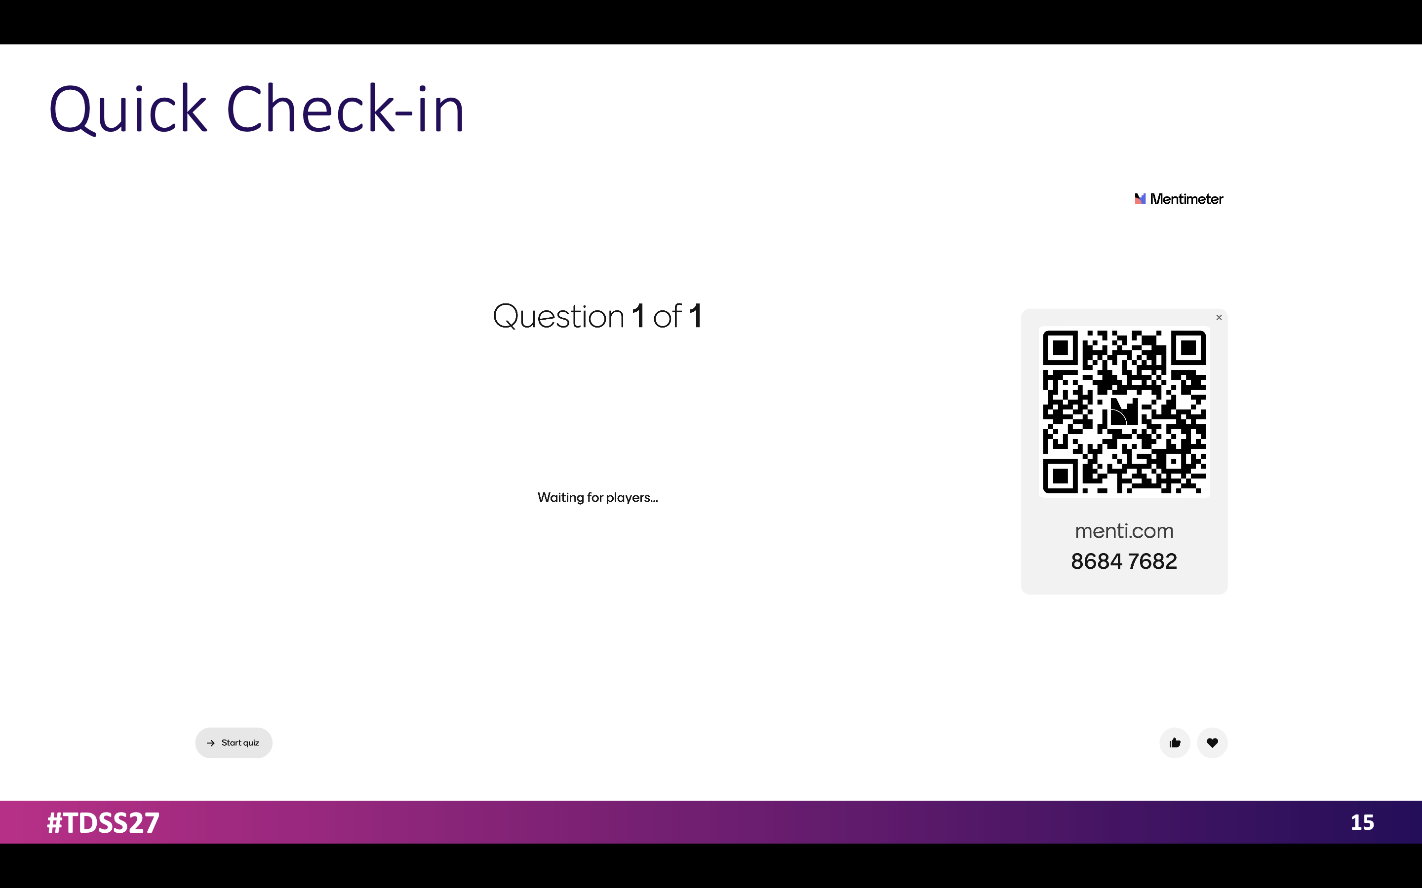
18

Slide 19
Insert Slide Title
Slide Subtitle
Ipis ut quibus, ut at quaspic te et. Sandite nobit aut ut qui rest rero.
Ipis ut quibus, ut at quaspic te et. Sandite nobit aut ut qui rest rero.
Ipis ut quibus, ut at quaspic te et. Sandite nobit aut ut qui rest rero.
Ipis ut quibus, ut at quaspic te et. Sandite nobit aut ut qui rest rero.
Ipis ut quibus, ut at quaspic te et. Sandite nobit aut ut qui rest rero.
Ipis ut quibus, ut at quaspic te et. Sandite nobit aut ut qui rest rero.
Ipis ut quibus, ut at quaspic te et. Sandite nobit aut ut qui rest rero.
Ipis ut quibus, ut at quaspic te et. Sandite nobit aut ut qui rest rero.

Slide 20
Insert Slide Title
Ipis ut quibus, ut at quaspic te et
Sandite nobit aut ut qui rest rero
Et unt opta quid qui sit quodi qui
Ipis ut quibus, ut at quaspic te et
Sandite nobit aut ut qui rest rero
Et unt opta quid qui sit quodi qui
Ipis ut quibus, ut at quaspic te et
Sandite nobit aut ut qui rest rero

Slide 21


Questions?
Speaker(s) Name(s), RD, LD, etc.
Your website
Your Facebook tag
Your Twitter handle
Your email
Second speaker’s email (if applicable)

Slide 22
References
Sandite nobit aut ut qui rest rero Ipis ut quibus, ut at quaspic te et
Sandite nobit aut ut qui rest rero Ipis ut quibus, ut at quaspic te et
Sandite nobit aut ut qui rest rero Ipis ut quibus, ut at quaspic te et
Sandite nobit aut ut qui rest rero Ipis ut quibus, ut at quaspic te et
Sandite nobit aut ut qui rest rero Ipis ut quibus, ut at quaspic te et
Sandite nobit aut ut qui rest rero Ipis ut quibus, ut at quaspic te et
Sandite nobit aut ut qui rest rero Ipis ut quibus, ut at quaspic te et
Sandite nobit aut ut qui rest rero Ipis ut quibus, ut at quaspic te et
Sandite nobit aut ut qui rest rero Ipis ut quibus, ut at quaspic te et
Sandite nobit aut ut qui rest rero Ipis ut quibus, ut at quaspic te et

Slide 23
Insert Divider Title Here
(Optional Slide)
Insert divider subtitle here

Slide 24
Insert Divider Title Here
(Optional Slide)
Insert divider subtitle here

Slide 25
Insert Divider Title Here
(Optional Slide)
Insert divider subtitle here

Slide 26
Insert Divider Title Here
(Optional Slide)
Insert divider subtitle here

Slide 27
Insert Divider Title Here
(Optional Slide)
Insert divider subtitle here

